Slide 1


COFFEE SALES
ANALYSIS

Slide 2
The main objective of this project is to analyze the sales of a Coffee Shop with the help of data insights which will help enhance the performance of the shop with the help of MS Excel, based on Months and Days, let’s take an example of March (Wednesday) as an example analysis.

Slide 3
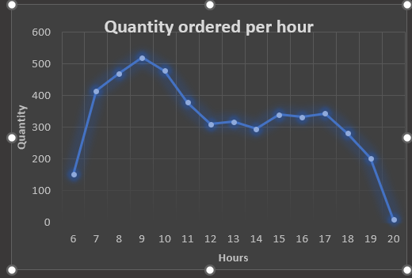
Here we are checking the peak hours, in which the finding is around 9 A.M

Slide 4
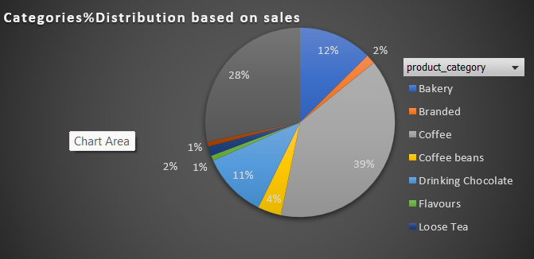
Now we are checking which Product category sold the most ,and the answer is Coffee

Slide 5
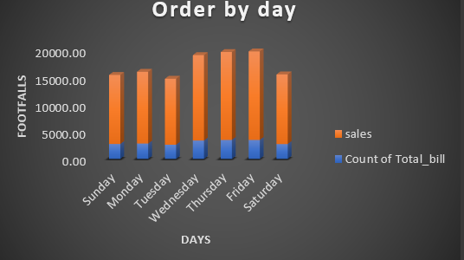
Here we are checking the order by day based on the footfalls in which found Friday just followed by Thursday has the most footfalls

Slide 6
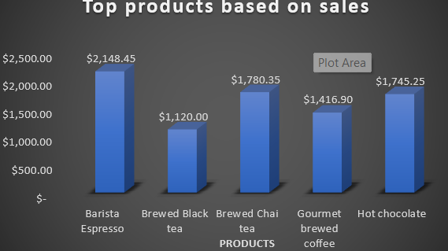
Now checking top products based on sales in which Barista Expresso tops the chart

Slide 7
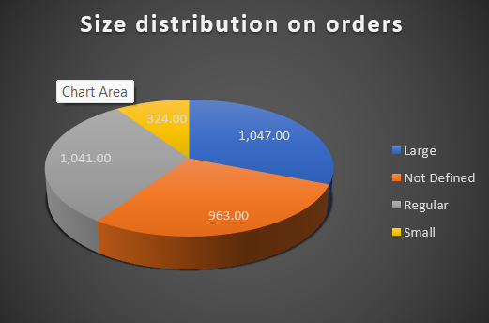
Size distribution on orders in which Large has the largest share

Slide 8
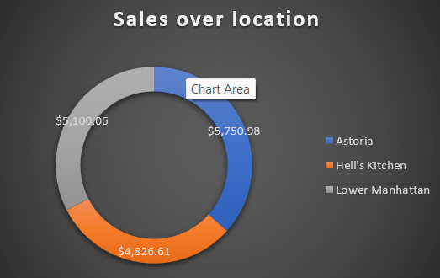
Talking about Sales over the location, Astoria has got the highest sales

